Slide 1
Xpath & Its Types

Slide 2
Xpath
It is a syntax or language for finding any element on the web page using XML path expression.
XPath is used to find the location of any element on a webpage using HTML DOM structure.
There are two types of XPath:
1) Absolute Xpath
2) Relative Xpath

Slide 3
Absolute Xpath
Single slash is used to create XPath with absolute path
i.e. the XPath would be created to start selection from the root node/start node/parent node.
Ex: /html/body/div[1]/div[1]/div[1]/div[1]/div[1]/div[3]/div[1]/input
Disadvantage:
If any changes made in the path of the element then that Xpath get failed

Slide 4
Relative Xpath
The path starts from the middle of the HTML DOM structure.
It starts with the double forward slash (//), which means it can search the element anywhere at the webpage.

Slide 5
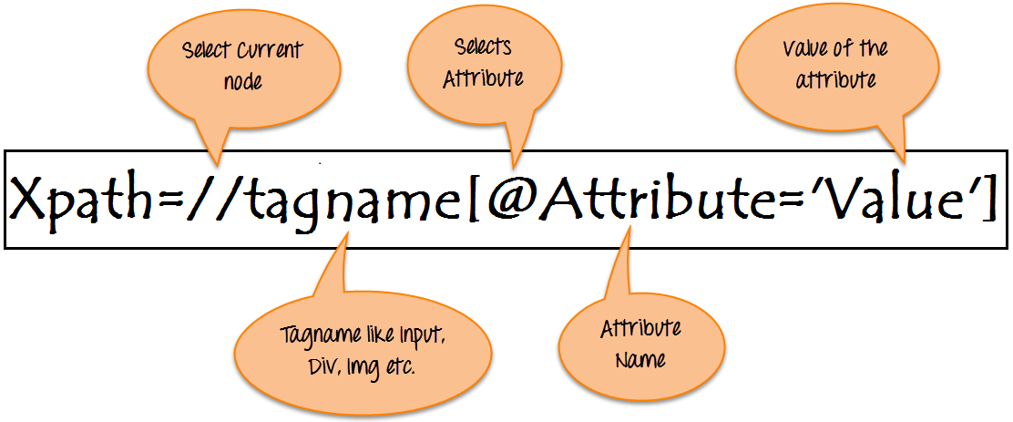
Relative Xpath Syntax

Slide 6
Locating elements with respect of elements and attribute
a. Locating elements with known attribute
Syntax: //*[@attributeName='value']
EG: //*[@Name='firstName']
b. Locating elements with known element and attribute
Syntax: //tagName[@attributeName='value']
EG: //input[@Name='firstName']
c. Locating elements with known visible text (extract match)
Syntax: //tagName[text()='exact text']
EG: //*[text()='Bala']
d. Locating elements with part of the visible text (partial match)
Syntax: //tagName[contains(text(),'part of text’)]
EG: //input[contains(text(),’ForgotPassword’)]

Slide 7
Locating elements with respect of elements and attribute
e. Locating elements with multiple attribute
Syntax://tagName[@attribute1='value1'][@attribute2='value2'][@attribute3='value3’]
EG: //button[@name=‘login’][class=‘loginPage’]
f. Locating elements with starting visible text is known (starts-with using text())
Syntax: //tagName[starts-with(text(),'starting text’)]
EG: //input[starts-with(text(),’Forgot’]
g. Locating elements with known dynamic attributes values (starts-with and contains using attributes)
Syntax: //tagName[starts-with(@attributeName,'fixed prefix of the value’)]
EG: //input[starts-with(@Name=‘User’)]
Syntax: //tagName[contains(@attributeName,'part of the value’)]
EG: //input[contains(@Name=‘User’)]

Slide 8
Xpath Axes Methods
Axes methods are used to find those elements, which dynamically change on refresh or any other operations.
There are few axes methods commonly used in Selenium Webdriver like child, parent, ancestor, sibling, preceding, self, etc.

Slide 9
Locating elements relative to known element
a. Locating a parent element
Syntax: //<KnownXpath>/parent::tagName
EG: //input[@Name='firstName’]/parent::div
b. Locating a child element
Syntax: //<KnownXpath>/child::tagName
EG: //input[@Name='firstName’]/child::div
c. Locating ancestors(parent node, grandparent node..) of known element
Syntax: //<KnownXpath>/anchestor::tagName or //<KnownXpath>/anchestor::*
EG: //input[@Name='firstName’]/anchestor::input
d. Locating Descendant (child node , grandchild node,…) of known element
Syntax: //<KnownXpath>/Descendant::tagName or //<KnownXpath>/Descendant::*
EG: //input[@Name='firstName’]/ Descendant ::input

Slide 10
Locating elements relative to known element
e. Locating following elements(Immediate next node)
Syntax: //<KnownXpath>/following::tagName
EG:////input[@Name='firstName’]/following::input
f. Locating preceding elements (Immediate prevoius node)
Syntax: //<KnownXpath>/preceding::tagName
EG:////input[@Name='firstName’]/preceding::input
g. Locating following-sibling elements
Syntax://<KnownXpath>/following-sibling::tagName
EG:////input[@Name='firstName’]/following-sibling::input
h. Locating preceding-sibling elements
Syntax://<KnownXpath>/preceding-sibling::tagName
EG:////input[@Name='firstName’]/preceding-sibling::input

Slide 11
Xpath Using And & Or
Using AND:
Syntax: //<tag>[@attribute1=‘value’ and @attribute2=‘value’]
Ex: //*[@id=‘userid’ and @name=‘firstname’]
Using OR:
Syntax: //<tag>[@attribute1=‘value’ or @attribute2=‘value’]
Ex: //*[@id=‘userid’ or @name=‘firstname’]

Slide 12
References
https://www.guru99.com/xpath-selenium.html#18
https://www.w3schools.com/xml/xpath_nodes.asp

